Slide 1
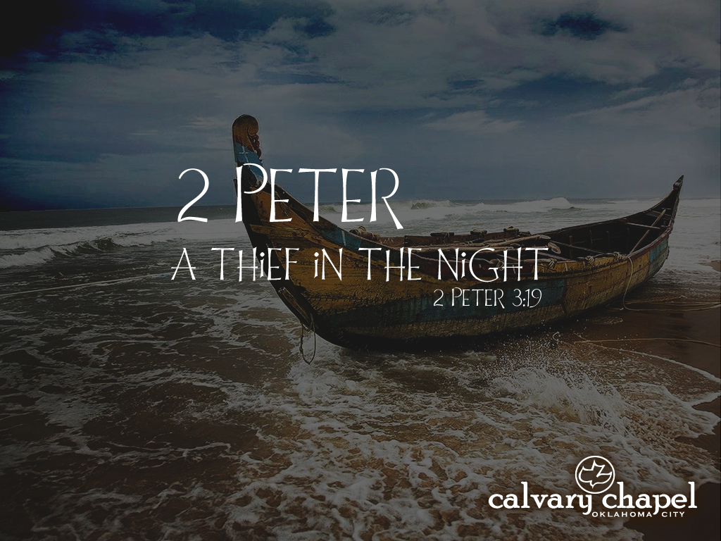
1:12-21

Slide 2


1:12-21
if …
GH can stand for
P as in hiccough
OUGH can stand for
O as in dough
PHTH can stand for
T as in phthisis
EIGH can stand for
A as in neighbor
TTE can stand for
T as in gazette
EAU can stand for
O as in plateau
“GHOUGHPHTHEIGHTTEEAU”
POTATO =

Slide 3

1:12-21

Slide 4
1:12-21
2 Peter 1:12-21 ~ ¹² For this reason I will not be negligent to remind you always of these things, though you know and are established in the present truth. ¹³ Yes, I think it is right, as long as I am in this tent, to stir you up by reminding you, ¹⁴ knowing that shortly I must put off my tent, just as our Lord Jesus Christ showed me. ¹⁵ Moreover I will be careful to ensure that you always have a reminder of these things after my decease.

Slide 5
1:12-21
2 Peter 1:12-21 ~ ¹⁶ For we did not follow cunningly devised fables when we made known to you the power and coming of our Lord Jesus Christ, but were eyewitnesses of His majesty. ¹⁷ For He received from God the Father honor and glory when such a voice came to Him from the Excellent Glory: “This is My beloved Son, in whom I am well pleased.” ¹⁸ And we heard this voice which came from heaven when we were with Him on the holy mountain.

Slide 6
1:12-21
2 Peter 1:12-21 ~ ¹⁹ And so we have the prophetic word confirmed, which you do well to heed as a light that shines in a dark place, until the day dawns and the morning star rises in your hearts;
²⁰ knowing this first, that no prophecy of Scripture is of any private interpretation, ²¹ for prophecy never came by the will of man, but holy men of God spoke as they were moved by the Holy Spirit.

Slide 7
1:12-21

Slide 8
1:12-21
Phil. 3:1b ~ For me to write the same things to you is not tedious, but for you it is safe.

Slide 9
1:12-21

Slide 10
1:12-21
KJV ~ I think it meet – i. e. “suitable,” “fitting”

Slide 11
1:12-21

Slide 12

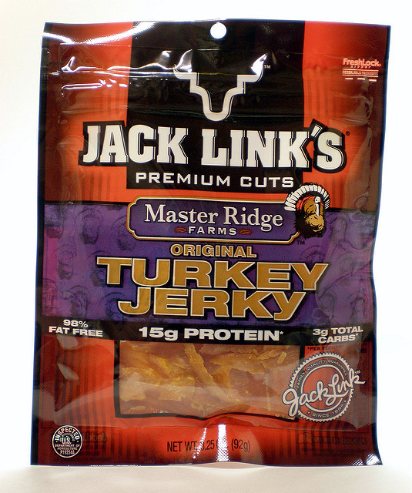
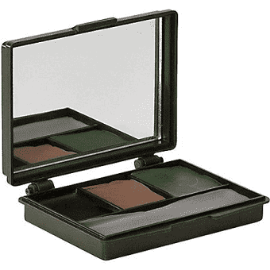
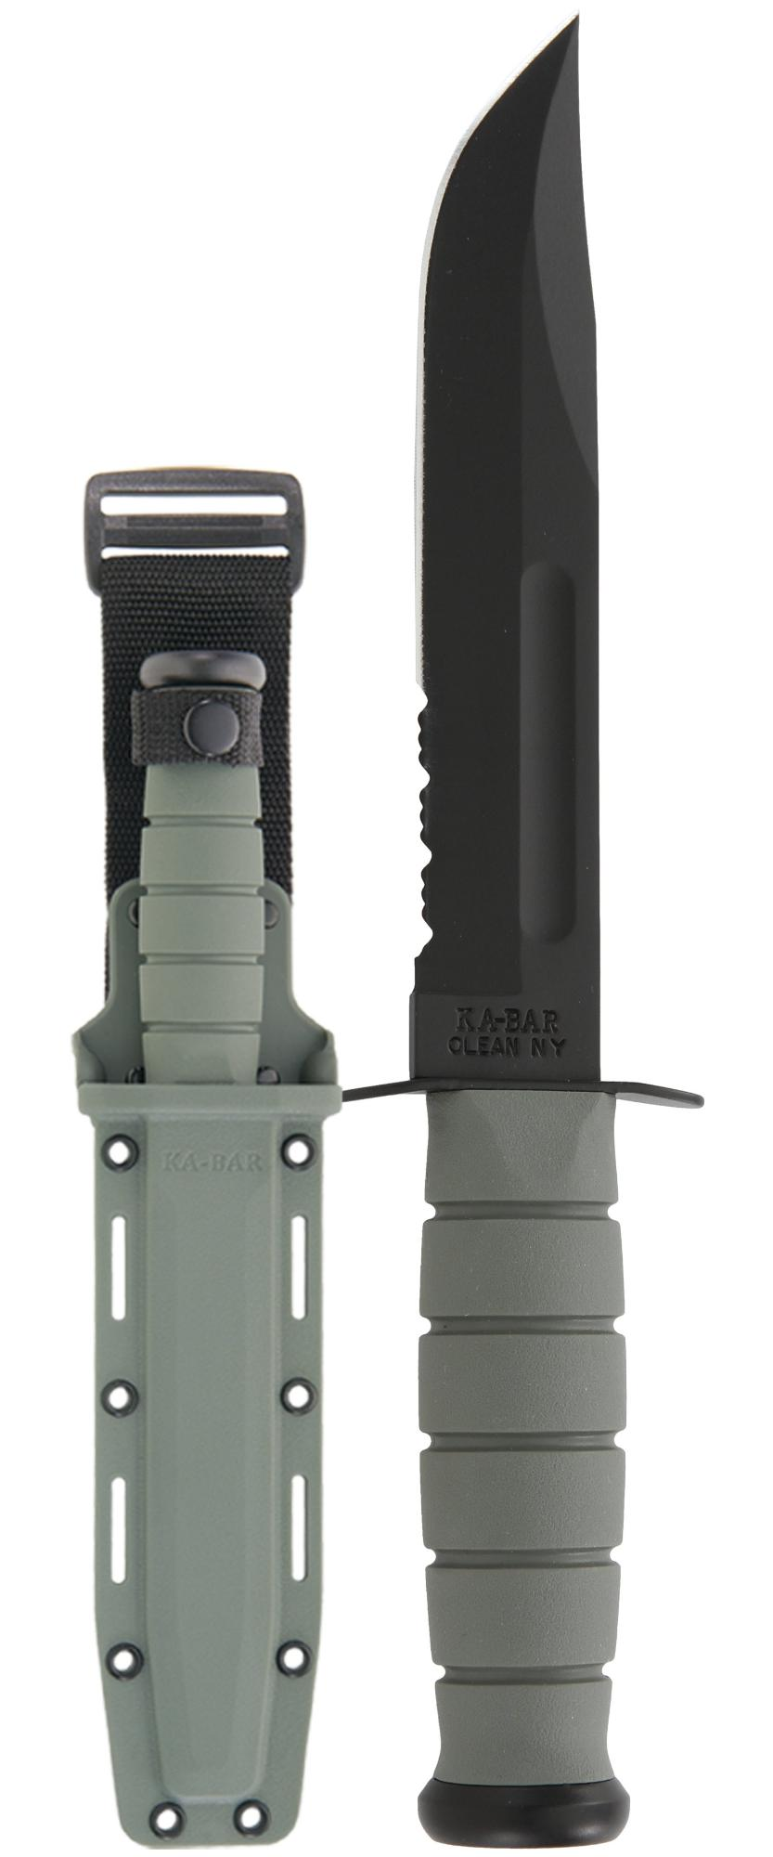
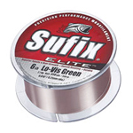
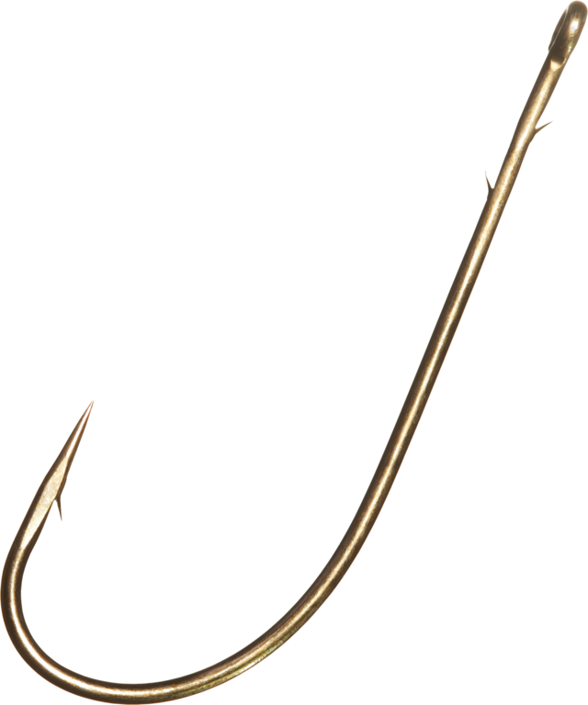
1:12-21
tent ~ skēnōma – from a compounded root meaning “vessel” and “shadow”

Slide 13
1:12-21

Slide 14
1:12-21
ensure you always have a reminder … ~ many Church Fathers see this as a reference to Gospel of Mark
decease ~ exodos – “departure”
Ps. 17:15 ~ As for me, I will see Your face in righteousness;
I shall be satisfied when I awake in Your likeness.

Slide 15
1:12-21

Slide 16
1:12-21
fables ~ muthos – myths

Slide 17
1:12-21

Slide 18
1:12-21
4
6
8
2
5
7
1
3
9
1 in 10
10

Slide 19
1:12-21
1:100
1 in 1 X 10² (1 in 10 X 10)
1:10,000
1 in 1 X 10⁴ (1 in 10 X 10 X 10 X 10)
1:10,000,000,000,000,000,000,000,000,000,000,000,000,000

Slide 20
1:12-21

Slide 21
1:12-21
1:10 men are bald
1:100 are missing one finger
1 in 1 X 10² (1 in 10 X 10)
Odds of both being bald and missing a finger?
1:1,000 would be bald and missing a finger
1 in 1 X 10³ (1 in 10 X 10 X 10)
1:1,000,000,000,000,000,000,000,000,
000,000

Slide 22

1:12-21
www.sciencespeaks.net

Slide 23
1:12-21
8 Old Testament prophecies concerning Jesus:
1. Micah 5:2 ~ But you, Bethlehem Ephrathah, Though you are little among the thousands of Judah, Yet out of you shall come forth to Me The One to be Ruler in Israel, Whose goings forth are from of old, From everlasting.
2. Mal. 3:1a ~ Behold, I send My messenger, And he will prepare the way before Me.

Slide 24
1:12-21
8 Old Testament prophecies concerning Jesus:
3. Zech. 9:9 ~ Rejoice greatly, O daughter of Zion! Shout, O daughter of Jerusalem! Behold, your King is coming to you; He is just and having salvation, Lowly and riding on a donkey, A colt, the foal of a donkey.
4. Zech. 13:6 ~ And one will say to him, “What are these wounds between your arms?” Then he will answer, “Those with which I was wounded in the house of my friends.”

Slide 25
1:12-21
8 Old Testament prophecies concerning Jesus:
5. Zech. 11:12 ~ Then I said to them, "If it is agreeable to you, give me my wages; and if not, refrain." So they weighed out for my wages thirty pieces of silver.
6. Zech.11:13 ~ And the LORD said to me, “Throw it to the potter” — that princely price they set on me. So I took the thirty pieces of silver and threw them into the house of the LORD for the potter.

Slide 26
1:12-21
8 Old Testament prophecies concerning Jesus:
7. Is. 53:7 ~ He was oppressed and He was afflicted, Yet He opened not His mouth; He was led as a lamb to the slaughter, And as a sheep before its shearers is silent, So He opened not His mouth.
8. Ps. 22:16 ~ For dogs have surrounded Me; The congregation of the wicked has enclosed Me. They pierced My hands and My feet;

Slide 27
1:12-21

Slide 28

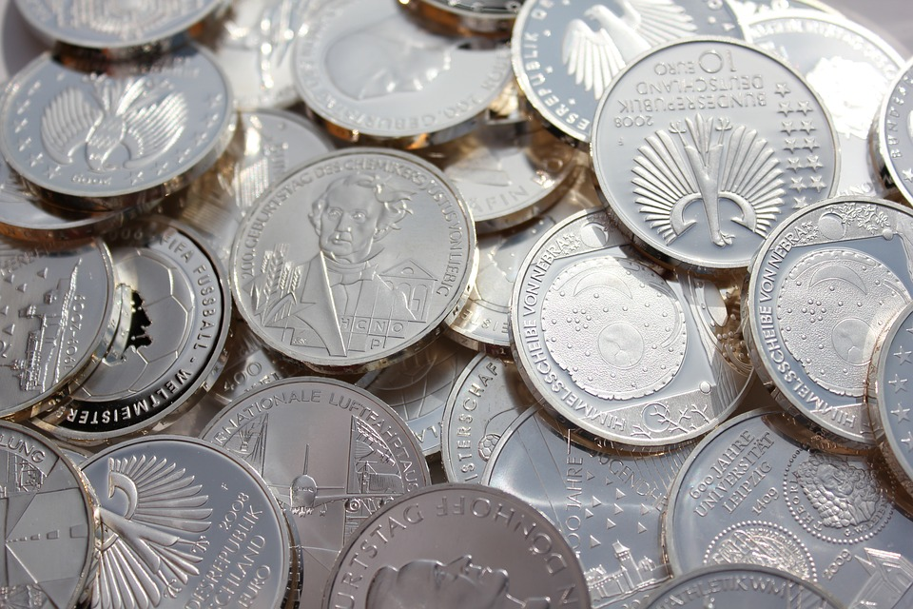
1:12-21
Fulfilling 8 prophecies is 1 in 10¹⁷
1 X 100,000,000,000,000,000
100 quadrillion

Slide 29



1:12-21
Fulfilling 16 prophecies is 1 in 10⁴⁵
1 X 1,000,000,000,000,000,000,000,000,
000,000,000,000,000,000,000
Scottzillion
Earth
Sun
A sphere 30x greater than the distance from the earth to the sun

Slide 30
1:12-21

Slide 31
1:12-21
3 imperative doctrines:
1. Who Jesus is: 1 John 4:2-3 ~ ² By this you know the Spirit of God: Every spirit that confesses that Jesus Christ has come in the flesh is of God, ³ and every spirit that does not confess that Jesus Christ has come in the flesh is not of God. And this is the spirit of the Antichrist, which you have heard was coming, and is now already in the world.

Slide 32
1:12-21
3 imperative doctrines:
1. Who Jesus is: 1 John 4:2-3
Merrihew Standard Version ~ This is how you can tell whether a belief is from God or not: Does it claim that Jesus is God incarnate? And any belief that Jesus is not God incarnate is not of God … in fact, it’s of the Antichrist.

Slide 33
1:12-21
3 imperative doctrines:
2. What Jesus did: Gal. 1:8 ~ But even if we, or an angel from heaven, preach any other gospel to you than what we have preached to you, let him be accursed.
3. His physical glorified resurrection: 1 Cor. 15:17 ~ And if Christ is not risen, your faith is futile; you are still in your sins!

Slide 34
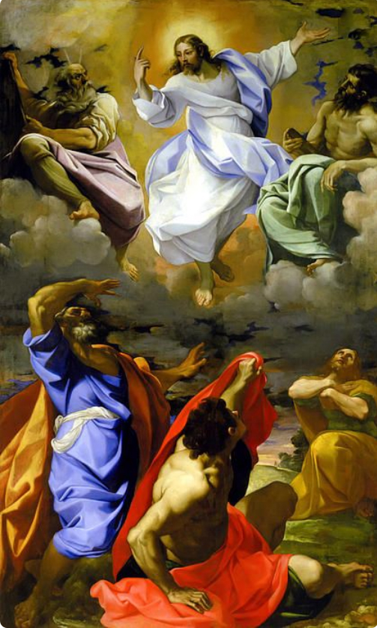
1:12-21
3 imperative doctrines:
He is the God/Man (halo)
His victory (speaking of what He would accomplish in Jerusalem)
His resurrection (with Moses and Elijah)

Slide 35
1:12-21

Slide 36
1:12-21
Wuest ~ And we have the prophetic word as a surer foundation …

Slide 37
1:12-21

Slide 38
1:12-21
morning star ~ phōsphoros

Slide 39
1:12-21

Slide 40
1:12-21
2 Pet. 1:20-21 (NLT) ~ ²⁰ Above all, you must realize that no prophecy in Scripture ever came from the prophet’s own understanding, ²¹ or from human initiative. No, those prophets were moved by the Holy Spirit, and they spoke from God.
1. Not of human origin
2. Not for human interpretation

Slide 41
1:12-21
1 John 2:27 ~ But the anointing which you have received from Him abides in you, and you do not need that anyone teach you; but as the same anointing teaches you concerning all things, and is true, and is not a lie, and just as it has taught you, you will abide in Him.

Slide 42
1:12-21
Jer. 29:11-13 ~ ¹¹ For I know the thoughts that I think toward you, says the Lord, thoughts of peace and not of evil, to give you a future and a hope. ¹² Then you will call upon Me and go and pray to Me, and I will listen to you. ¹³ And you will seek Me and find Me, when you search for Me with all your heart.

Slide 43
1:12-21

